Slide 1


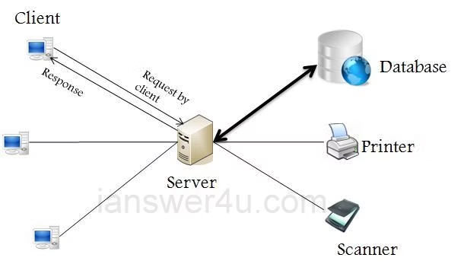

Client-Server Architecture
Client-server architecture is a common model for software systems. It involves two entities: clients and servers. Clients request resources from servers, which provide those resources.
VP
by Vivek Parmar

Slide 2
Understanding Servers
Hardware
Software
Network Connectivity
Servers are powerful computers designed for specific tasks. They typically have high processing power, ample memory, and robust storage.
Servers run specialized software that enables them to manage resources and respond to client requests. This software can be operating systems, databases, web servers, or application servers.
Servers connect to networks, allowing clients to access resources remotely. They have network interfaces that facilitate communication with other devices.

Slide 3

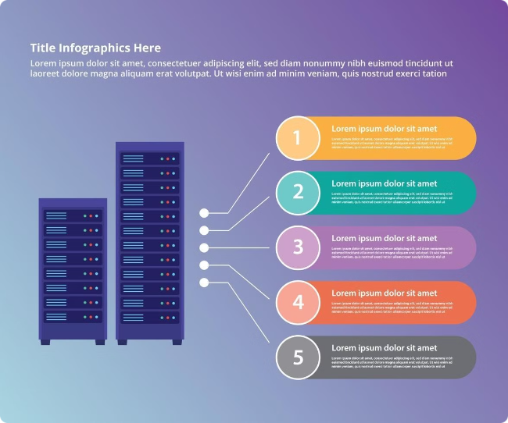


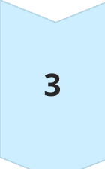
How Requests Are Handled by Servers
Request
A client sends a request to the server, typically through a network connection.
Processing
The server receives the request, interprets it, and processes it based on its configuration and installed software.
Response
The server generates a response based on the processed request and sends it back to the client.

Slide 4

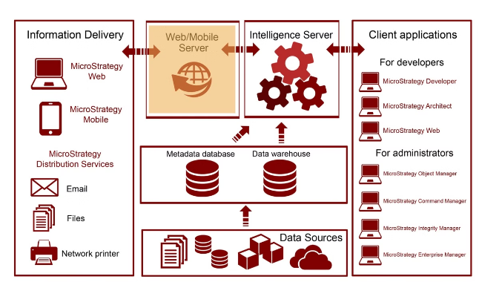
Server Components
1
CPU
2
Memory
The central processing unit handles the main processing tasks, executing instructions and managing data.
RAM (Random Access Memory) provides temporary storage for data and programs that the CPU needs to access quickly.
3
Storage
4
Network Interface
Hard drives or SSDs store data persistently, ensuring data remains available even when the server is powered off.
The network interface connects the server to the network, allowing communication with other devices.

Slide 5

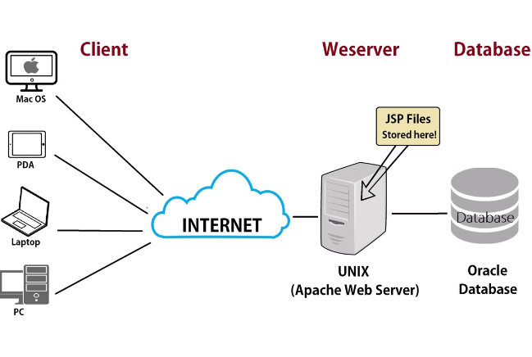
Server Processes
1
Operating System
The operating system manages the server's hardware and resources, providing a foundation for other software.
2
Application Services
These services handle specific tasks like web serving, database management, or email processing.
3
User Processes
These processes represent applications or tasks that users initiate, leveraging server resources to complete tasks.

Slide 6

Server Protocols
HTTP
Hypertext Transfer Protocol. Used for web communication, transferring files and data between clients and web servers.
FTP
File Transfer Protocol. Enables secure file transfers between clients and servers, commonly used for uploading and downloading files.
SMTP
Simple Mail Transfer Protocol. Handles the transmission of emails between email clients and servers.
SSH
Secure Shell. Provides a secure and encrypted connection for remote access and administration of servers.

Slide 7
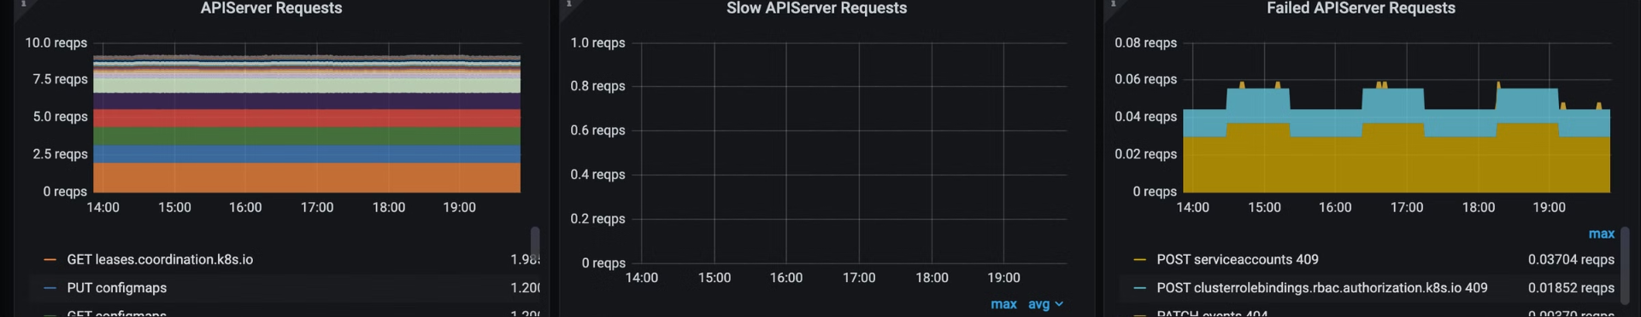




Server Performance
Response Time
Load
Resource Utilization
Uptime
How quickly the server responds to client requests, measured in milliseconds.
The amount of traffic the server is handling, impacting its ability to respond promptly.
How efficiently the server uses its resources, such as CPU, memory, and storage.
The percentage of time the server is operational and available to clients.

Slide 8


Server Security
Firewall
Antivirus Software
A software or hardware barrier that controls network traffic, blocking unauthorized access to the server.
Software that detects and removes malware, protecting the server and data from malicious attacks.
Regular Updates
Strong Passwords
Keeping the operating system, applications, and security software up-to-date is crucial to patch vulnerabilities.
Using strong and unique passwords for server administration and user accounts helps prevent unauthorized access.

